Slide 1
Simple FPGA SDR
Unallocated Space Minicon (July 2015)
David Protzman

Slide 2
Overview
Motivation
Goals
Equipment
Design
Testing
Demo
Future Plans

Slide 3
Motivation
Lots of small bandwidth (< 5 MHz) SDRs available
RTL2832 (1.5 MHz)
FunCube (96 KHz)
Loads of homebrew HAM SDRs (< 1MHz)
Some higher bandwidth (> 5 MHz) SDRs available, but expensive (> $150)
Ettus Research USRP
HackRF
BladeRF
MyriadRF

Slide 4
Motivation
5 MHz is too small a bandwidth
$150 is too much money
I have several high speed ADCs laying around (50 MSPS+) from other projects
Just completed the FFT project from the FPGA class
How hard could it be?

Slide 5
Goals
Sample as fast as possible
Move the data to a computer in some way
This is how the data will be displayed and/or processed
Pretty straight forward goals right?

Slide 6
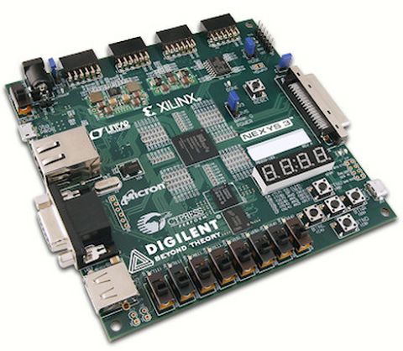
Equipment
Several choices for FPGAs to process the data
Chose FPGAs for this design because they can process the data in real time with little effort
Decided on the Nexys3 from Digilent Inc
Has built in 10/100 Ethernet with a simple MII interface that is well documented (no NDA required)
Already had two on hand!
Great in case one gets bricked :(
Had already done some work with receiving Ethernet packets with this board
Enough GPIO for the ADC

Slide 7
Equipment
For the ADC, an AD9283 was chosen
Already had several on hand from the FPGA classes
Simple parallel interface
Sampling rate up to 50 MSPS
Already soldered to breakout boards
Even had some breadboards already wired up :)
Yes, breadboards… Not the best for high speed signals

Slide 8
Equipment
Filtering a requirement for sampling
You can’t just sample directly off an antenna and expect magic!
Simple RC low pass filters were used
Terrible for real RF work, but fine for dorking around
The basic idea is to filter off any frequencies above half your sampling rate
This prevents aliasing which is essentially signals above your sampling rate that end up folding over into your sampled signal
Really good to avoid this if at all possible!

Slide 9
Design
Here is the basic idea of the whole thing:
Gather X samples from the ADC
Samples are buffered in a First In First Out (FIFO) queue
Once the buffer is full, flush all of the data out to a pipeline that wraps the data in the following protocols:
UDP
IP
Ethernet
Send the new Ethernet frame out to the computer
View the results in GNU Radio
Find aliens

Slide 10
Design
The reason for wrapping everything in UDP is that GNU Radio natively supports UDP capture
This means there are no blocks to have to write
Everything just works!

Slide 11
Design
Gathering and buffering samples is really easy in an FPGA
The harder part is assembling the three protocols
In a CPU things happen sequentially
You have to force your code to be parallel
In an FPGA things happen in parallel
You have to force it to be sequential
To make this design fast, everything needs to be always progressing
No stopping for things like CRC or checksum calculations!
The easiest way to accomplish this is pipelining
The output of one stage connects to the input of another
The outputting module tells the input module when it’s time to process data (usually called a ‘data valid’ flag)

Slide 12
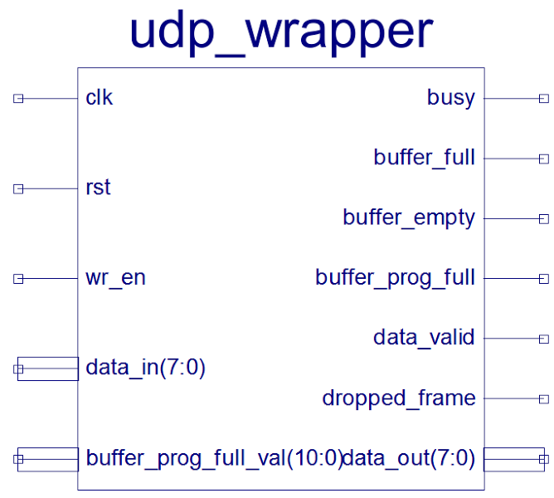
Design - UDP Module
Let’s take a look at the UDP module as an example
This is the schematic symbol of the module that encapsulates a buffer of samples in a UDP frame
There are some flags to monitor the buffer status
But the main things are:
clk : clock that drives this module
rst : reset the module
wr_en : data is being written to this modules buffer
data_in : the ADC samples
data_valid : tells the next module that the data leaving data_out is valid and contains a UDP frame
data_out : Where the new UDP frame is output
busy : A UDP frame is being created

Slide 13
Design - UDP Module
The actual code for the UDP wrapper is ~ 200 lines
There isn’t much logic, but there are a lot of intermediate ‘variables’ to work with
The basic flow is:
Wait for wr_en to go from low to high
Buffer the data coming in (raw samples from the ADC)
Wait until wr_en goes from high to low (means that writing has stopped)
Set data_valid and busy high as the UDP header and payload are output
The port numbers are supplied at compile time
Set data_valid and busy low
Wait for more data
Oh, and the checksum is zeroed out
Turns out checksumming UDP is a pain

Slide 14
Design - UDP Module
One important thing to watch for is that the module is not told to write a frame while it’s currently writing a frame
This can happen if the frame size of data is too small
Suppose that each frame of raw samples was 4 bytes (4, 8 bit samples)
The UDP wrapper will have to output 8 + buffer_size bytes
12 bytes in this case (8 for the UDP frame, 4 for payload)
There is no way that 12 bytes can leave the module before 4 bytes make it back in
This causes an error which the dropped_frame flag shows
Right now this error will completely hose up the pipeline :(
This is a problem for all of the wrappers (Ethernet, IPv4, and UDP)

Slide 15
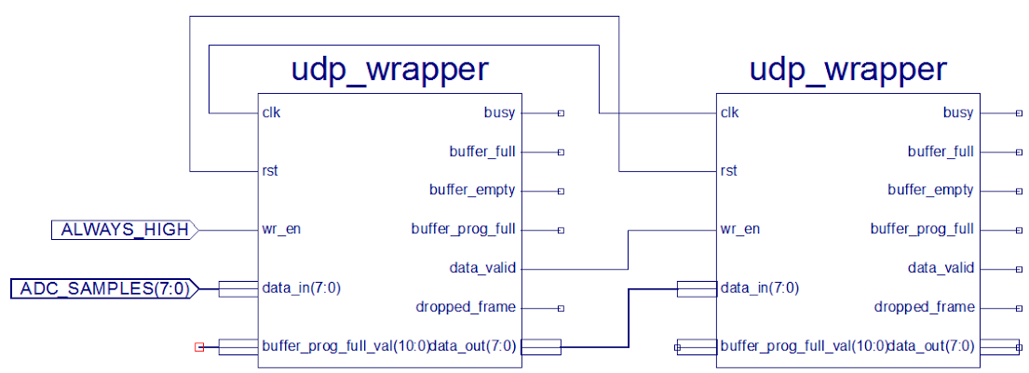
Design - Chaining
But, enough of the specifics
Because this module outputs that the data leaving is valid (and not just garbage), we can chain these together!
This would create UDP frames that contain UDP frames
Not terribly useful, but a simple example
The clk and rst signals must be shared between the two to maintain timing

Slide 16
Design - IP and Ethernet
The IP and Ethernet modules work in exactly the same way
The only differences are:
IP:
The checksum is calculated on the data as it comes in, and then the header while data is being output
The header is checksummed at compile time serves as the starting checksum for the data
No need to recalculate something that never changes
Can’t skip this checksum like in UDP :(
Ethernet:
The CRC cannot be done out of order like the checksum in IP
Thankfully the CRC comes at the end so it can be calculated as the data is being output!

Slide 17
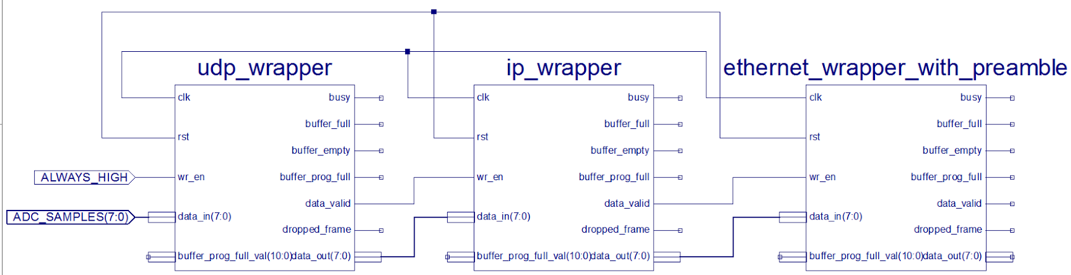
Design - Complete Chain
To wrap the ADC samples in all three frames:
The output of the Ethernet wrapper is a valid Ethernet frame containing an IP header, UDP header, and the raw samples payload

Slide 18
Design - Ethernet Gotchas
It turns out that Ethernet is a little tricky
It isn’t just dest MAC, source MAC, protocol ID, payload, and CRC
When transmitting frames through an Ethernet PHY chip (what the Nexys3 has onboard) you also have to transmit the Ethernet preamble
0x55 55 55 55 55 55 55 D5
This took a long time to figure out…
This is why the previous slide shows the Ethernet module as ethernet_wrapper_with_preamble
To simplify the pipeline, the Ethernet wrapper also adds in the preamble
That way the module that actually transmits the frame doesn’t need to worry about it

Slide 19
Design - Transmission
The last step is to transmit the data
To make things easy, most Ethernet PHY (physical interface) chips use MII (Media Independent Interface)
For 100 Mbit/sec that means that 4 data bits are sent on each 25 MHz clock
The only odd thing about MII is that each byte is transmitted with the first 4 low bits, then the last 4 high bits
Odd, but easy to accomplish on an FPGA
Remember, FPGAs operate on bits, not just bytes!

Slide 20
Design - Configuration
Each of the wrapper modules are configurable at compile time
This is done to keep the modules simple
Ex:
The IP wrapper allows the source and destination IPs to be set as well as the TTL and next level protocol
Future versions might have the ability to change some of this on the fly

Slide 21
Design - Rates
With the data ready for GNU Radio, a sampling rate needs to be determined
100 Mbit Ethernet can transfer at 100,000,000 / 8 => 12.5 MBytes/sec
This is before taking protocols into consideration
The combination of Ethernet, IP, and UDP causes the addition of 54 bytes of data
Ethernet preamble (8), header (14), and CRC (4)
IP header (20)
UDP header (8)
Plus the Ethernet inter-packet gap of 12 bytes
All this means that the raw samples cannot go up to 12.5 MBytes/sec
More like a little under 10 MBytes/sec

Slide 22
Design - Rates
Assuming that 10 MB/s is the target, that means that only 5 MHz of spectrum can be sampled
The Nyquist rate says that you must sample at least twice the highest frequency you wish to collect
2 * 5 MHz = 10 MHz
Since each of the samples is 8 bits, that translates to 80 Mbits/sec
This is fairly close to the max of 100 Mbits/sec of the Ethernet link once you add in the protocol overheads

Slide 23
Testing
To make sure this idea worked, a DDS was used to create a test signal
DDS here means Direct Digital Synthesis
The Xilinx development environment (ISE) has a DDS module that can generate sine waves at whatever frequency
(Limited by the clock speed)
Using the 8 switches on the Nexys3, the sine wave frequency could be varied
The output of this DDS (8 bit samples) was fed into the same input that the ADC would use
Thus getting as close to an accurate test as possible
Then the samples could be viewed in GNU Radio to see if everything was working

Slide 24
Demo
Live demo of the loopback test

Slide 25
Using an ADC
After passing the loopback test the loopback connection was removed and an ADC put in it’s place
The original design was a breadboard with a 50Msps ADC and RC filter
Then I got my hands on a Black Gold ADC/DAC board
eBay link
The one problem is that the filter on board is designed for 30 Msps which is wayyyy too fast for 100 Mbit/s Ethernet
Remember, 10 Msps is the fastest 100 Mbit/s ethernet can run for this purpose
So, there will be aliasing issues :(
This can be solved by sampling at 30 Msps and using a FIR filter to both filter and decimate the signal down to 10 Msps
Still trying to make that part play nice =\

Slide 26
Demo
Live demo of the full sampling pipeline using a Black Gold ADC/DAC and a function generator

Slide 27
That’s All Folks!
Questions/Comments/Concerns?

Slide 28
Other Stuffs
Check out the GitHub page for this FPGA design
http://github.com/unallocated/FPGA-MISC/ethernet_test
There are plenty of other cool FPGA projects at the Unallocated Space GitHub page
http://github.com/unallocated
While you’re there check out some of the other code from Unallocated Space!
This presentation was prepared for the July 2015 Unallocated Space Minicon
Check out http://www.unallocatedspace.org for details about Unallocated Space

